Slide 1

EMB-101: Emergence of Bangladesh Class -4
British India:1858-1911

Slide 2
British India:1858-1911
Topics to be covered:
The Aftermath of the first war of independence (1857)
Rise of nationalism and change in the British policy
First partition of Bengal in 1905
Swadeshi movement
Electoral and administrative reforms

Slide 3
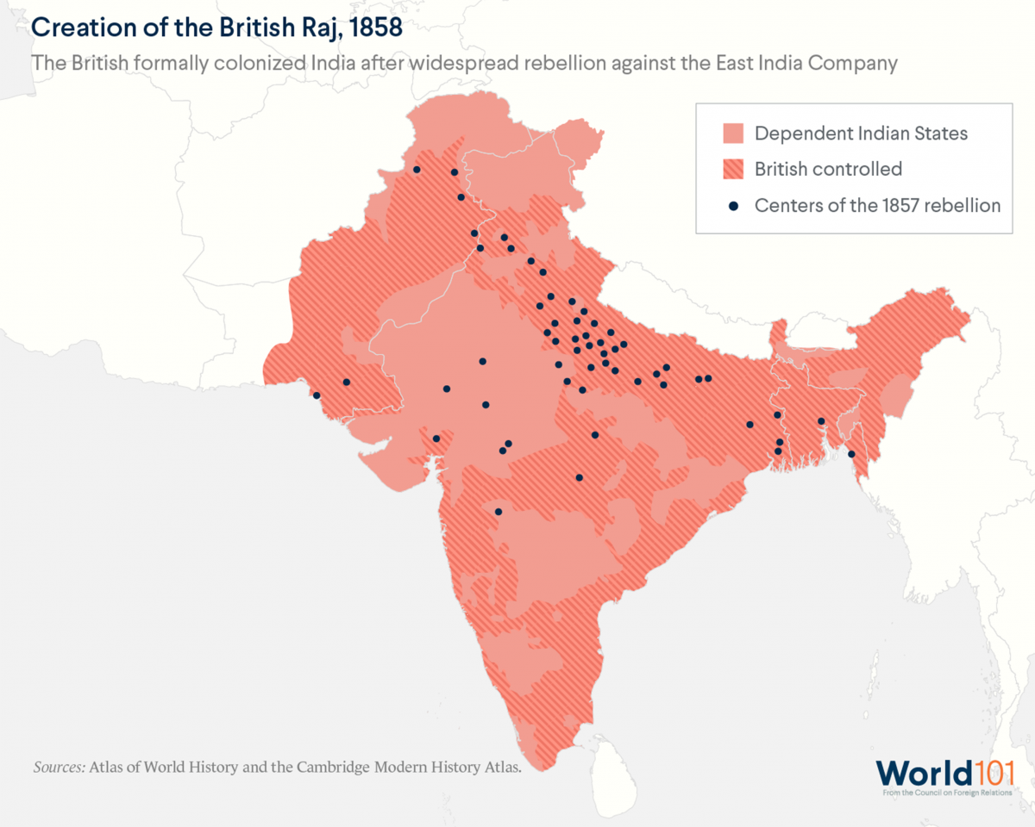
Crown Rule, 1858
The British Crown took over the rule of colonial India and abolished the East India Company

Slide 4
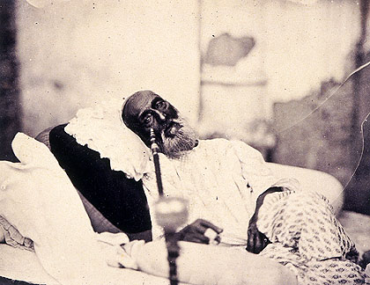
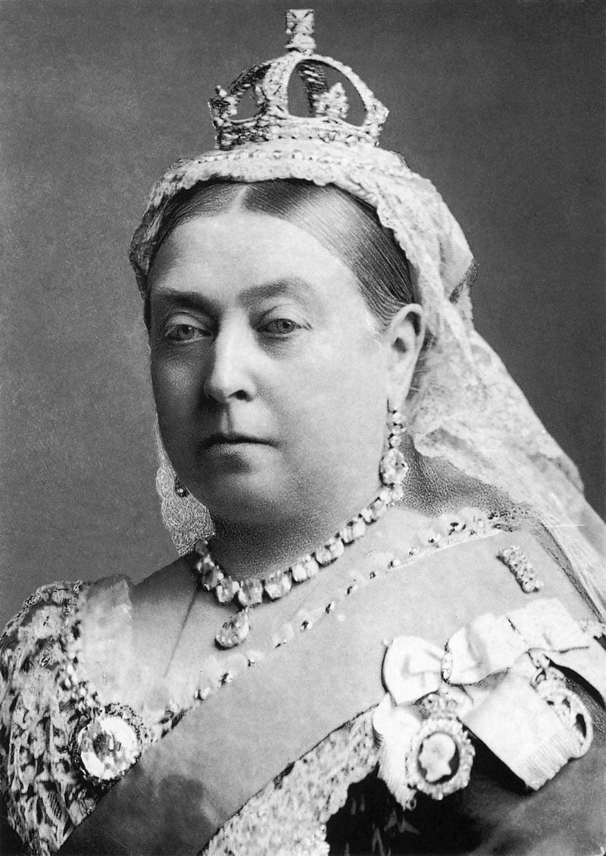
The Empire in Transition
Bahadur Shah Zafar in 1858, just after his trial in Delhi and before his departure for exile in Rangoon. This is possibly the only photograph ever taken of a Mughal emperor.
Queen Victoria became the Empress of India

Slide 5
Muslim awakening
Hunter Commission
British Inclination towards Muslims
Mohammedan Literary Society was founded by Nawab Abdul Latif in Kolkata in 1863
Aligarh Movement
All India Muhammadan Education conference 1886

Slide 6
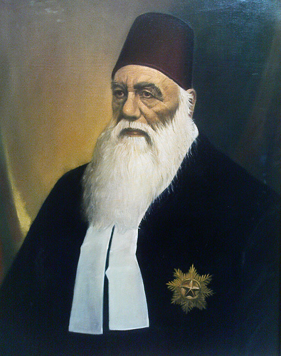
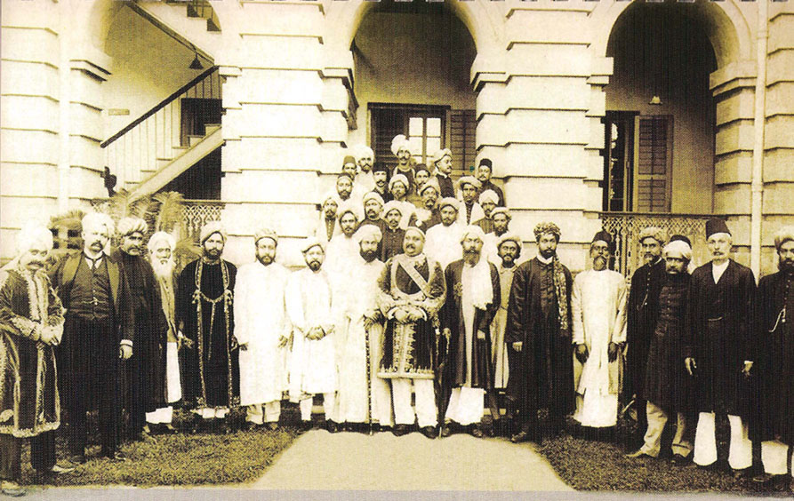
Muslim awakening
SIR SYED AHMAD KHAN
Nawab Salimullah with local elites

Slide 7
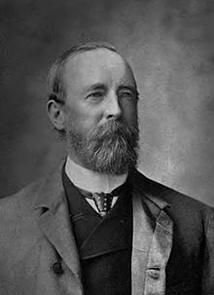
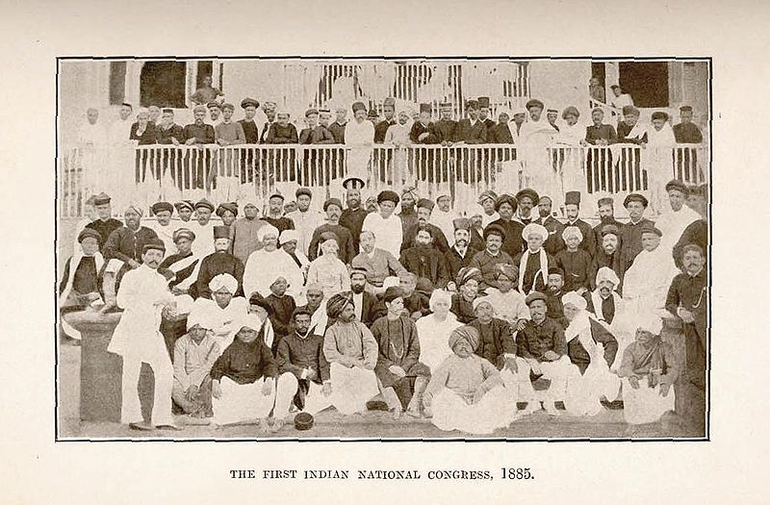
Nationalism and the rising demand for participatory politics
Indian Councils Act 1861
Indian Councils Act 1892
Allan Octavian Hume
1st Indian National Congress, 1885

Slide 8
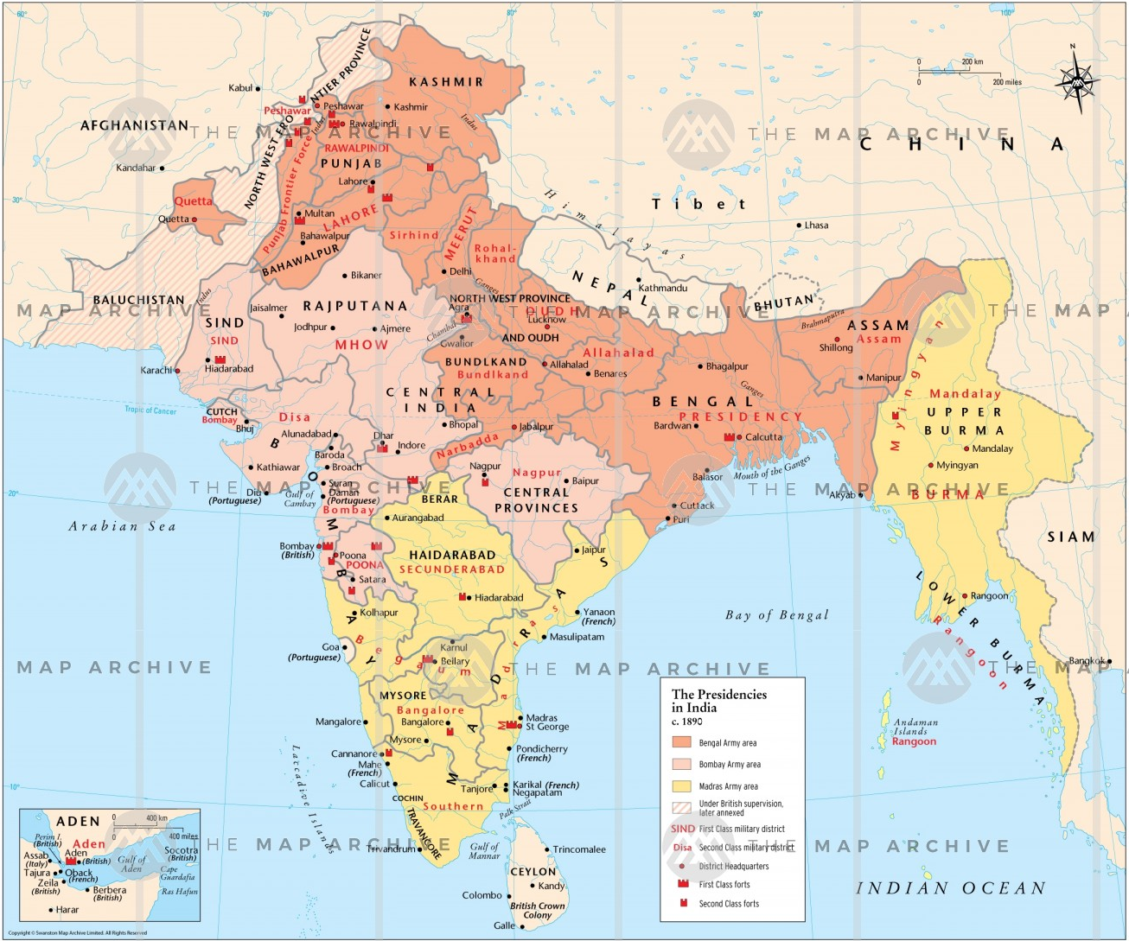
The Presidencies in India c.1890
Bengal Presidency
Madras Presidency
Bombay Presidency

Slide 9
First Partition of Bengal: 1905
Lord Curzon, Viceroy of India 1899-1905) enacted the partition of Bengal
October 16, 1905
Eastern province (East Bengal and Assam) with Muslim majority
Western province (West Bengal, Bihar and Orissa) with Hindu majority

Slide 10
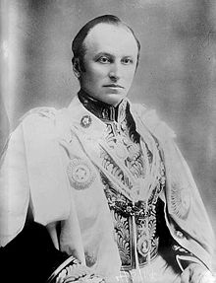
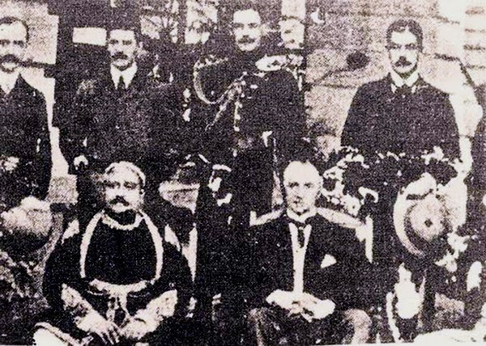
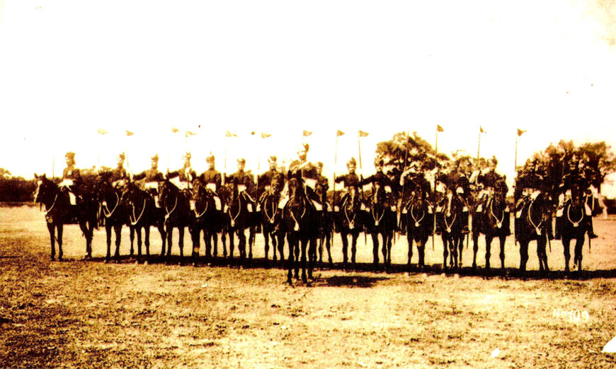
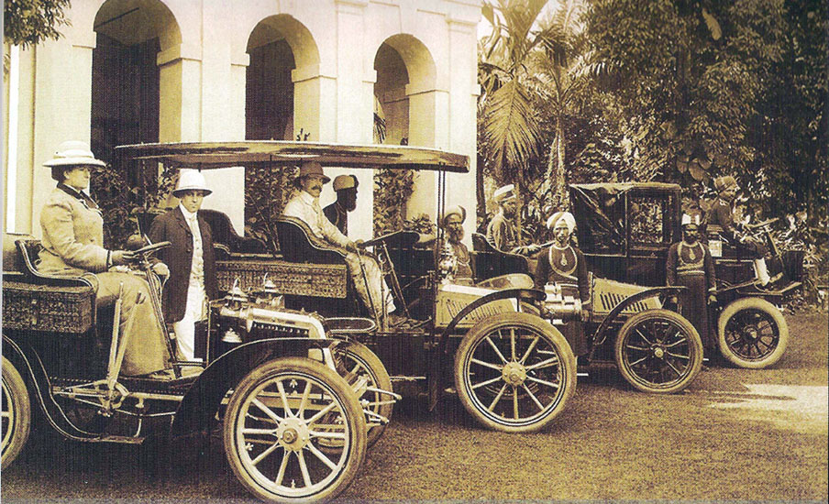
First Partition of Bengal: 1905
Curzon in Dacca
Lord Curzon
Lord Curzon with Nawab Sir Salimullah in Ahsan Manzil ,1904
Viceroy Curzon's Escort at Dacca in 1904
In 1904, Lord Curzon at Shahbagh, Dhaka

Slide 11
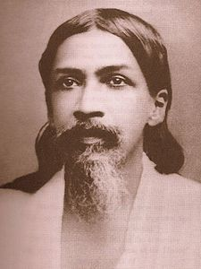
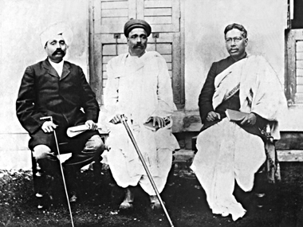
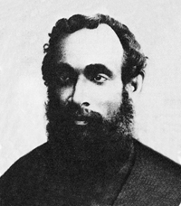
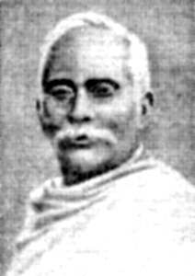
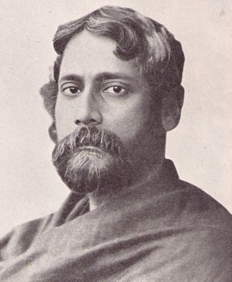
Swadeshi Movement
Lala Lajpat Rai,
Bal Gangadhar Tilak
&
Bipin Chandra Pal –
The three leaders who played vital role in Swadeshi Movement
Sri Aurobindo Ghosh
Surendranath Banerjee
Aswini Kumar Dutta
Rabindranath Tagore in 1905

Slide 12
Swadeshi Movement
Annul partition
Establish self rule
Boycott British goods
Engage in civil disobedience
Commit political assassinations

Slide 13
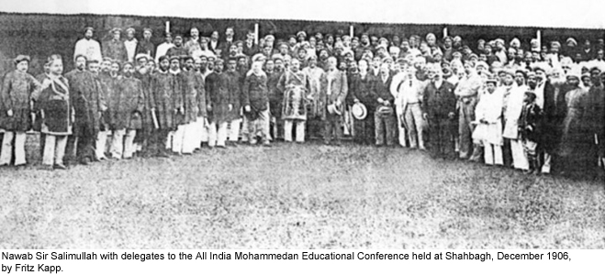
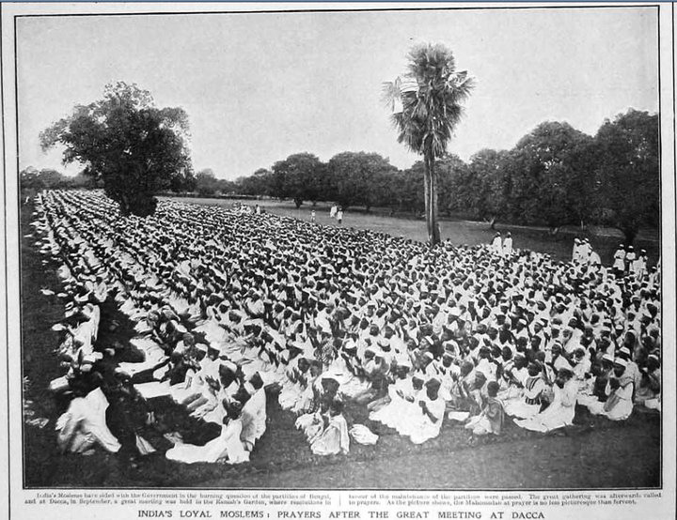
Muslim Response
Prayer gathering after a meeting at Dacca in 1906
This AIME conference laid down the foundation of Muslim League
All India Muslim League was formed on 30 December 1906

Slide 14
The Morley-Minto Reforms, 1909
Indian National Congress;
Moderates agreed
Extremists rejected
Major Provisions of the Act
Members of the Legislative Council at the Center was increased from 16 to 60
Provincial: Bengal, Madras and Bombay- 50, Other- 30
Separate electorate for Muslims
Majority: Centre- officials , Province- non-officials
Members: permitted to discuss budget, suggest amendments and can vote on them
Muslim League
Welcomed the reforms and offered cooperation

Slide 15
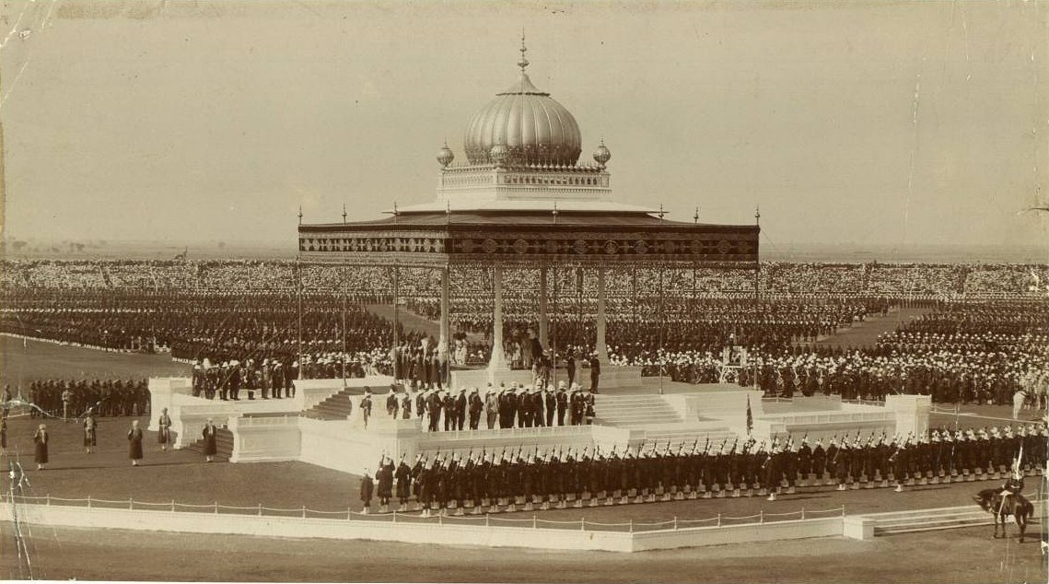
Annulment of the Partition, 1911
The Delhi Durbar of 1911, with King George V and Queen Mary seated upon the dais.

Slide 16
Annulment of the Partition and its Impact
Negatively affected the unity of INC. Radicals were excluded
Violent political reaction to partition created Hindu-Muslim communal tension
Two fronts of anti-colonial nationalist politics. 1) Hindu nationalism 2) Muslim nationalism

Slide 17
Suggested Readings
Bose, Sugata & Jalal, Ayesha, Modern South Asia: History, Culture, Political Economy (New York and London: Routledge, 2004)
Bandyopadhyay, Sekhar, From Plassey to Partition: A History of Modern India (New Delhi: Orient Longman, 2004)
Schendel, Willem Van, A History of Bangladesh (New York: Cambridge University Press, 2009)
Metcalf, Barbara D. &amp; Metcalf, Thomas R., A Concise History of Modern India (Cambridge:Cambridge University Press, 2006)
Sarkar, Sumit, Modern India: 1885-1947 (New Delhi: Pearson, 2014)

Slide 18
?

Slide 19
Topics for the next classes
Class 5: Introduction to book review
Class 6: British India: 1912-1947

